Slide 1


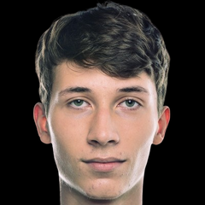
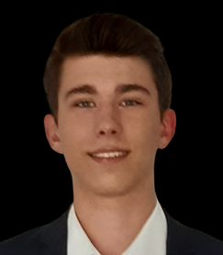
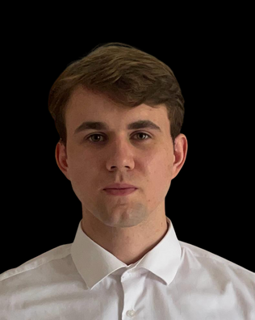
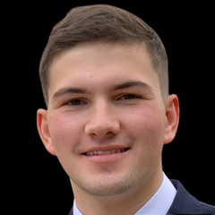
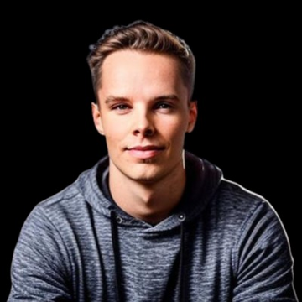
QUANTUMQUESTERS
Pitch Deck Presentation
Julius
Kliem
Kai
Mechler
Business Informatics
Fullstack
Business
Informatic
Frontend
Sven Thomes
Andrey Stoyanov
Stefan
Rogalski
Mathematics
QA
Business Informatics
Fullstack
Business Informatics
PM
QuantumQuesters
Notes:
Welcome
Quantum Questers
And in the last 24hours...

Slide 2

QUANTUMQUESTERS
Help the world by reducing your emissions.
With your friends and companions.

Slide 3

QUANTUMQUESTERS
Pitch Deck Presentation
Make a fast impact with your traveling behaviour.
Notes:
Traveling and Commuting

Slide 4
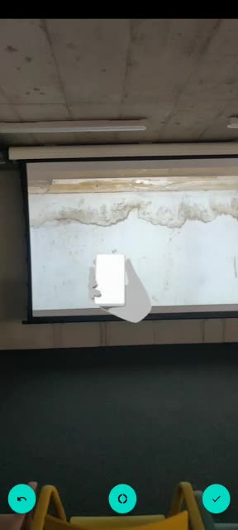
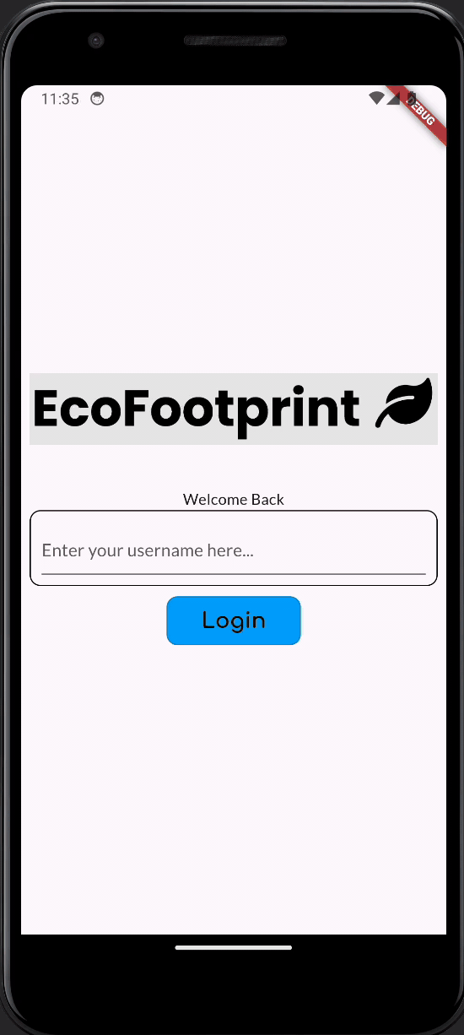
QUANTUMQUESTERS
Pitch Deck Presentation
Calculate CO2 Emissions for your Trips
Notes:
In the last 24 hours we developed

Slide 5
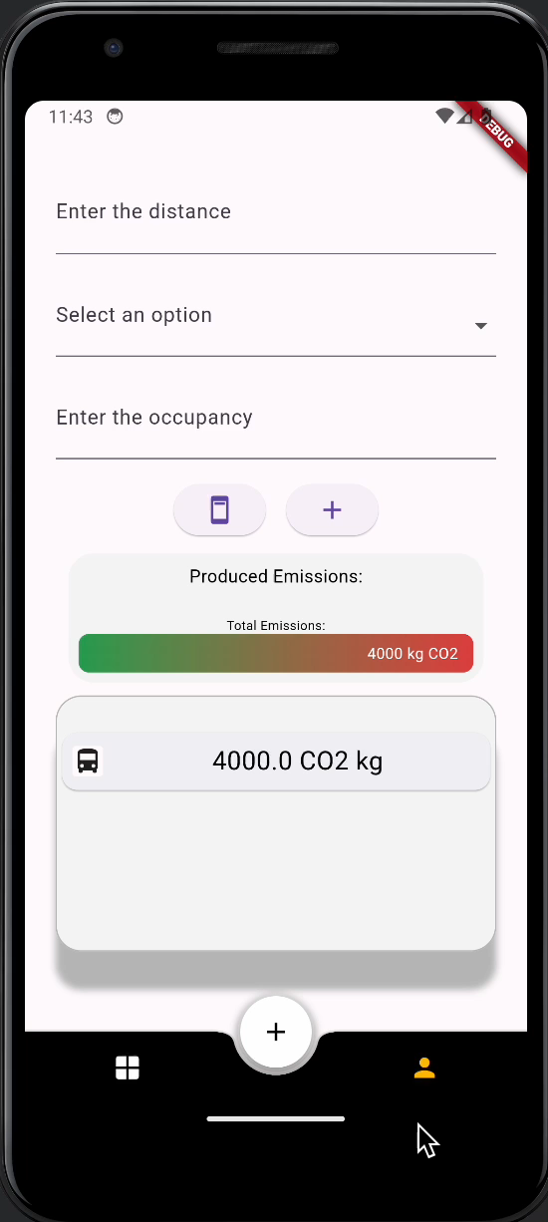
QUANTUMQUESTERS
Pitch Deck Presentation
Compare yourself with Friends and Colleagues

Slide 6
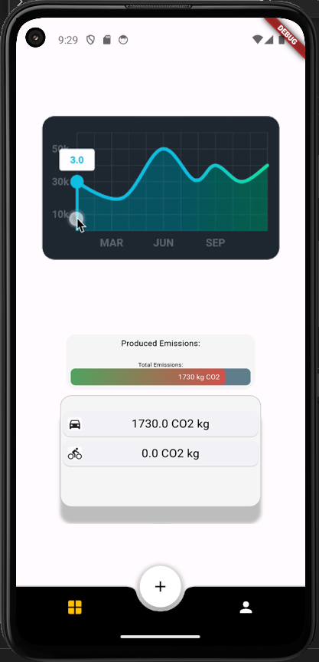
QUANTUMQUESTERS
Pitch Deck Presentation
Set Yourself Sustainability Goals

Slide 7
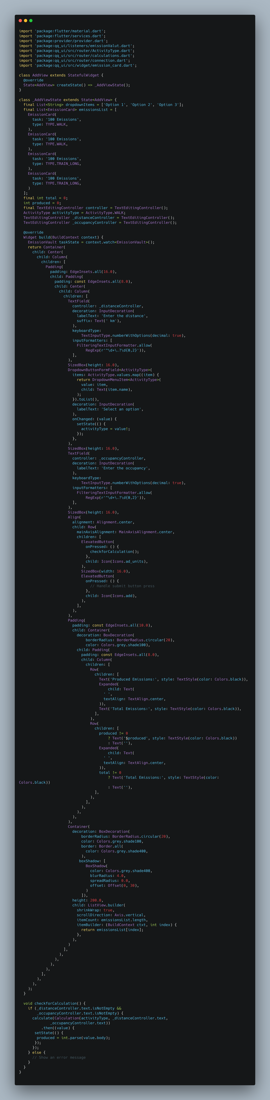
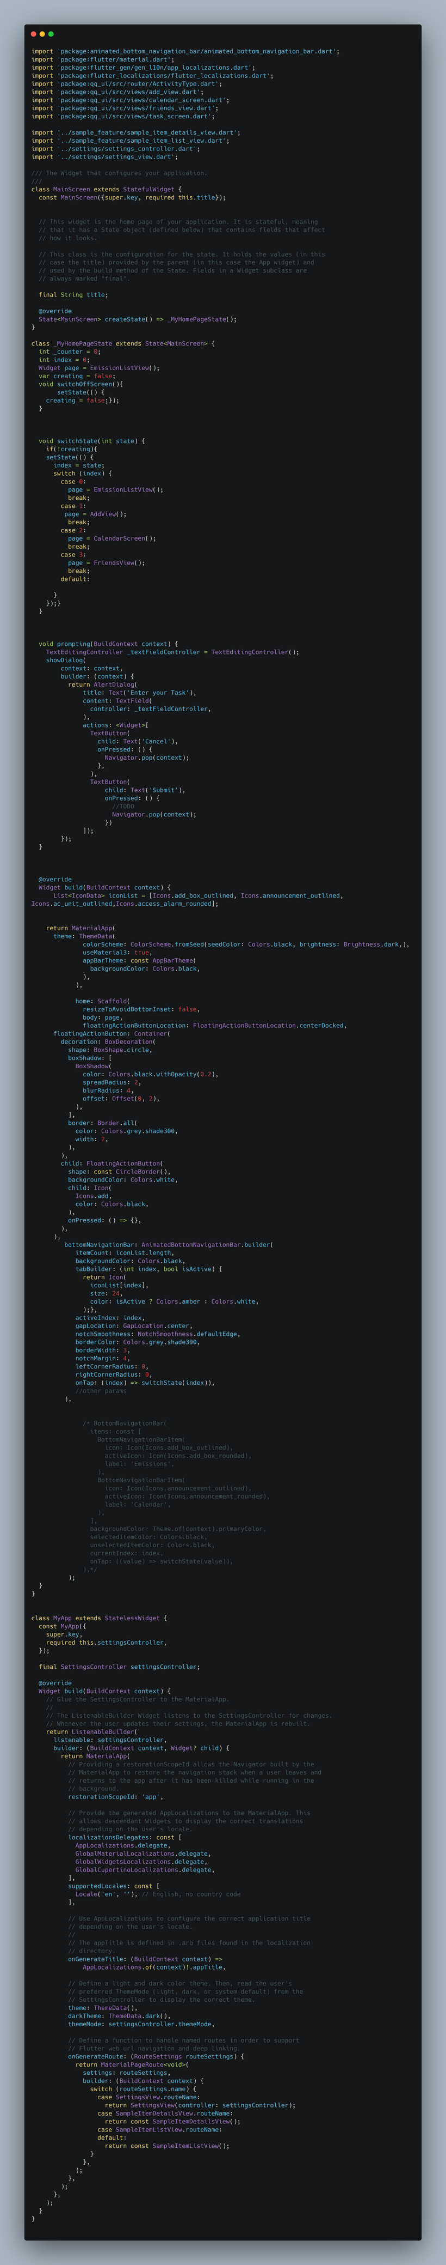
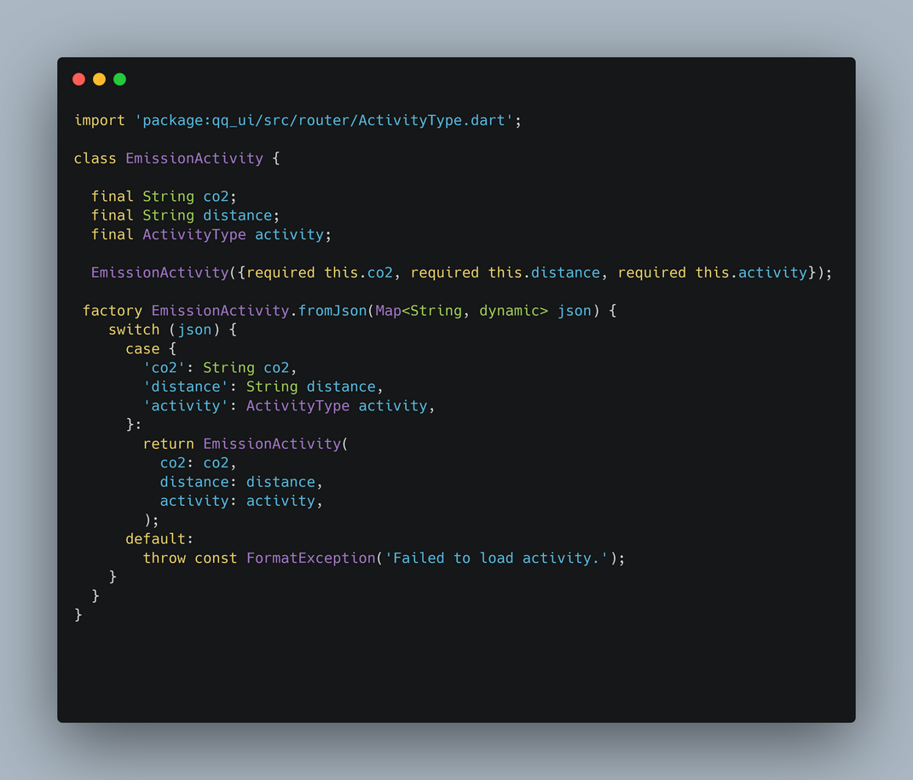
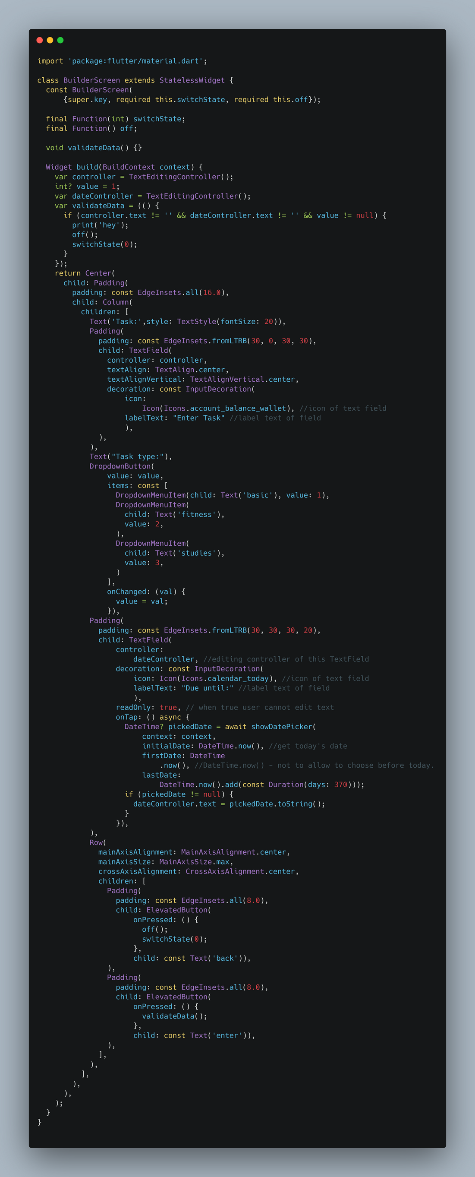
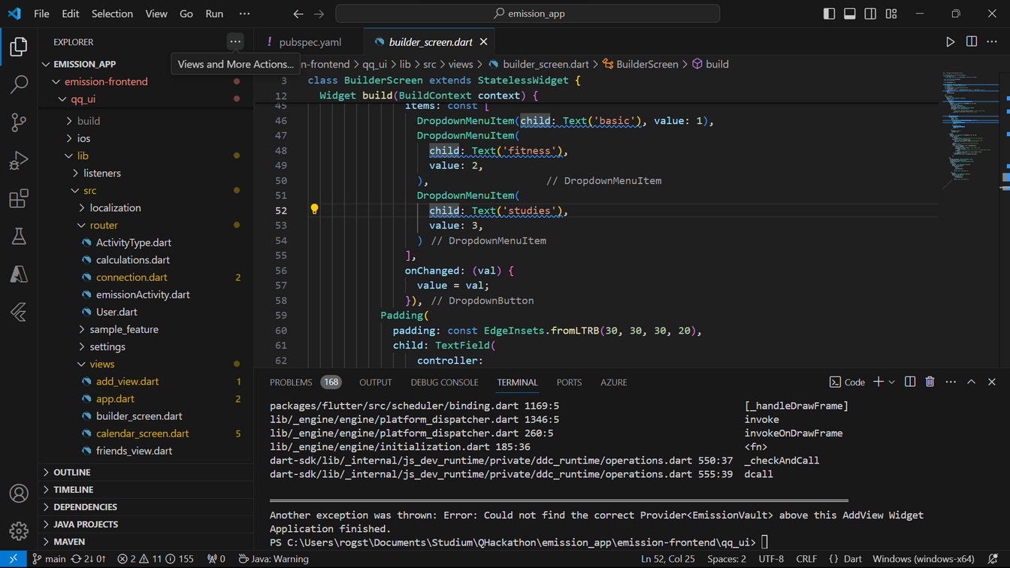
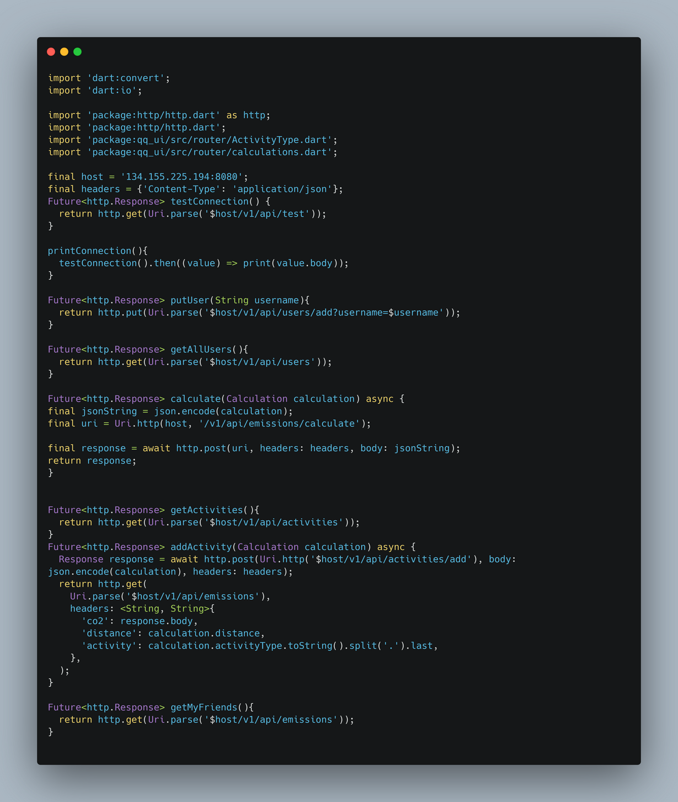
QUANTUMQUESTERS
The Tech Stack
Pitch Deck Presentation
Frontend:
Flutter (Cross-platform UI framework)
Backend:
Spring Boot (Java framework)
Azure (Cloud computing platform)
Database:
Superbase (Open-source Backend-as-a-Service)
Development Environment:
Visual Studio Code (IDE)
Containerization:
Docker (Containerization technology)
Version Control:
GitHub (Version control and collaboration platform)

Slide 8
QUANTUMQUESTERS
Reduce your emissions.
With your friends and companions.
https://github.com/AndreyJRE/emission_app

